Slide 1


SHEEB
The sole habit tracker for you, habit slacker.

Slide 2
Table of Contents
Initiator
2
3
4
5

Slide 3
Initiator
Embark on an extraordinary expedition with the Habit Tracker app - SHEEB, where the horizons of habit formation are expanded beyond the ordinary.
Envision a realm where the alchemy of gentle intentions and the magic of subconscious rewards transform the very fabric of our being.
Here, we do not shy away from the depths of the human psyche; instead, we navigate its waters with the compass of modern psychology, charting a course towards a renaissance of self-improvement.
Our methodology does not just engage the senses; it captivates them, harnessing their power to forge an indomitable spirit.
We revive the ancient wisdoms of "No pain, no gain," "Pain brings joy," and "Suffering leads to thriving," casting them in the new light of our collective journey towards greatness. Join us in redefining the art of living.

Slide 4
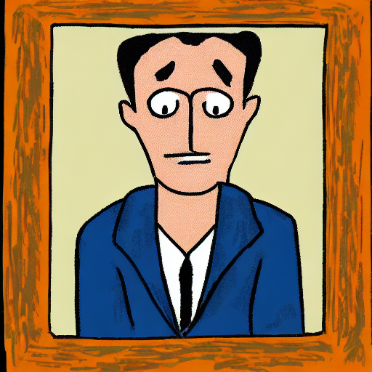
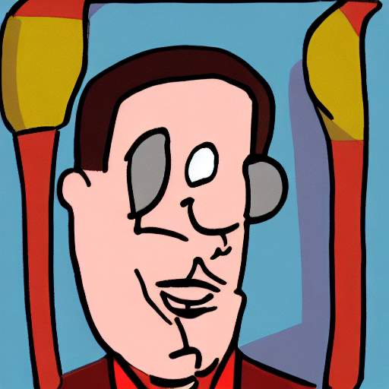
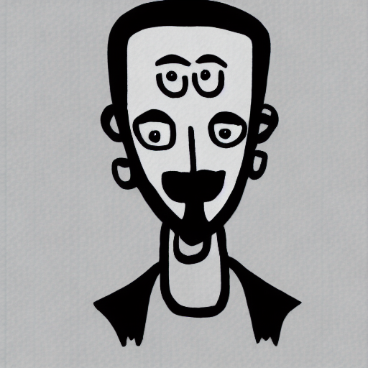
Mock - Up
PICK YOUR TODAY MOOD
EGG HEAD
NORMIE
METAL HEAD

Slide 5
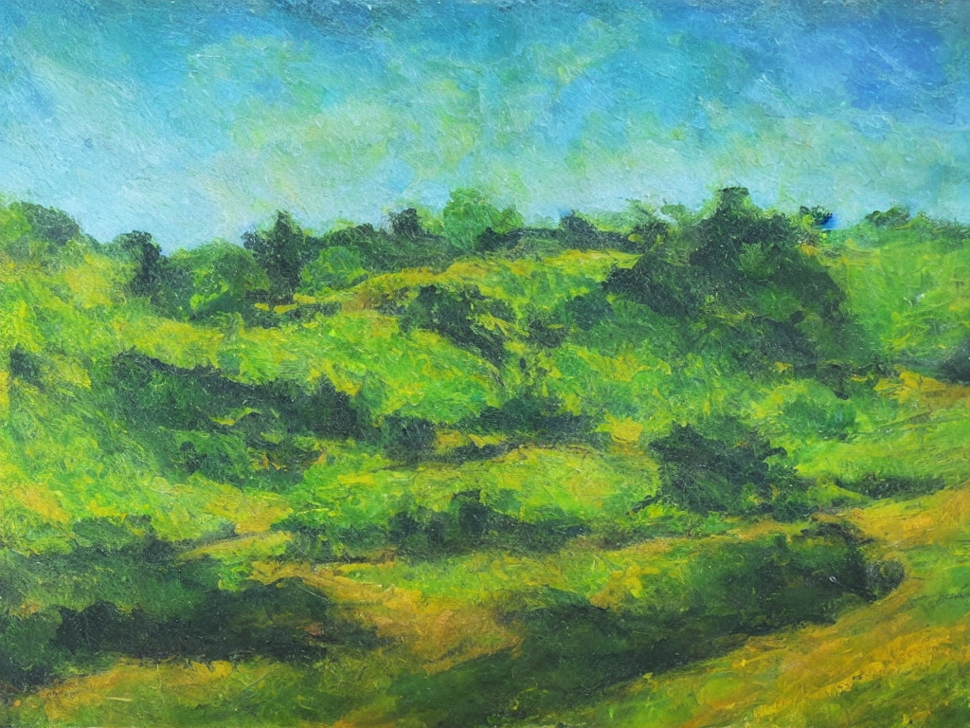
Mock - Up
EVERYONE HAS BAD DAY, GIVE YOURSELF A REST !
All your todo - stat will be reduce by 50% since you are a fucking slacker. Worth nothing anyway, so 50% is good enough.
Your reward will be reduced by 5% accumulative for each consecutive day.
80% of your reward deduction will be reserved at motivation stash.
Until you finish all your “Rinser” tasks, you would earn back all your reward deduction.
EGG HEAD

Slide 6

Mock - Up
ANOTHER DAYS, ANOTHER GOALS
Reward will be appreciated by 10% for each consecutive successful day.
Appreciation percent will be reduced by half for any incompletion day.
More to come…!
NORMIE

Slide 7

Mock - Up
HEADBAND, RINSE, AND REPEAT
Doer – M E n T A L i t y !!! You don’t need tasks, task needs you !!!
Earn special ability: For every 3 – day headbanging till failure, you earn a pass for extra rest day. Fail to exercise the pass benefit will result you in burnt-out due to excessive energy and over-working.
Well, in other words, take a fking rest, you workaholic!!!
METAL HEAD

Slide 8

Mock - Up
HomePage
Create your first step to start !
Here are some suggestions for you:
Walking the dog
Jogging/Running 5km daily
Make your bed
Cooking 2 meals per day
Meditation before/after bed

Slide 9
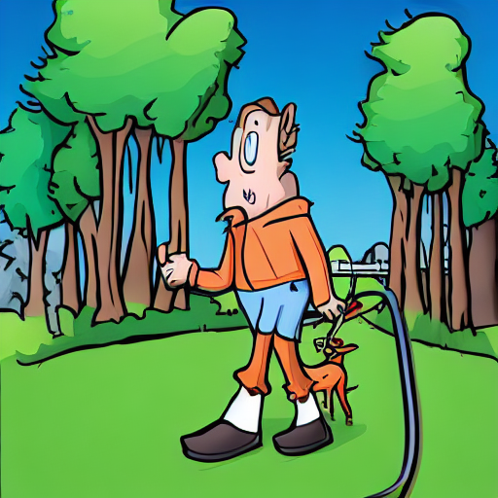
Mock - Up
Habit info - #clickedHabit
Difficulty (String) : Easy like a piece of cake
Duration (Time) : 15 mins
Days of week : 7 days
Description (String) : Walking the dog, or you will have to clean up the mess later which will take you an hour, and hot-headed.
Mantra (String) : 15 mins of walking burnt you 15 calories (make up number), 365 days will help you burn 5475 calories which equal 15 big fatty oily Jiro- style ramen.
Walking The Dog (String) #ID 001 (PK)

Slide 10
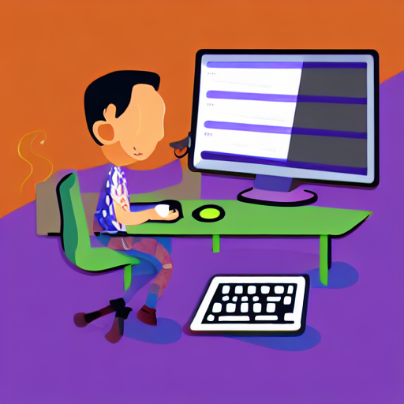
Mock - Up
Habit info - #clickedHabit
Difficulty (String) : Hard Rock Hallelujah
Duration (Time) : 2 hours
Days of week : 7 days
Description (String) : Code, Sleep, Repeat. Yeah, you read it right. Javascript is your love, is your life now. Spend times with her, else you will not make it to senior level.
Mantra (String) : There is old saying “10,000 hours to become master”, new saying “In AI -powered world, master at anything in 1,000 hours”. 1000 / 2 = 500 days = 1.3698630137 years = 1 years 4 months 13 days 4 hours to become a true master.
Coding Frontend (String) #ID 002 (PK)

Slide 11
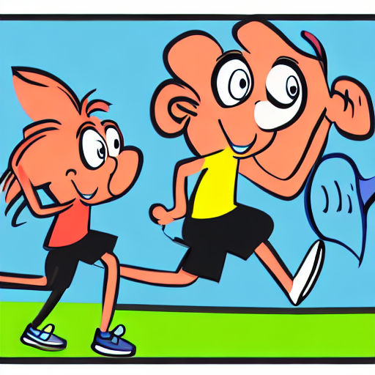
Mock - Up
Habit info - #clickedHabit
Difficulty (String) : Hard Canon Rock
Duration (Time) : 45 mins
Days of week : 4 days
Description (String) : 5km Park run, walking if needed. Start slow. Pace yourself.
Mantra (String) : first step is always the hardest; first 500m is the first wall which people get bonked when they start running. Then it will be 3km, 5km, 10, 15, 21, 30, 35, 42, then ultra. Crazy people will do ironman, ultra distance, trail, mountain, or even space racing.
Running (String) #ID 003 (PK)

Slide 12
Mock - Up
CALENDAR
MONDAY | TUESDAY | WEDNESDAY | THURSDAY | FRIDAY | SATURDAY | SUNDAY
EZ 1 EZ 2 NOR 1 NOR 2 HARD 1 | NOR 1 NOR 2 HARD 1 | HARD 1 | REST DAY | HARD 1 HARD 2 HARD 3 HARD 4 | NOR 1 NOR 2 NOR 3 EZ 1 HARD 2 | NOR 3 HARD 1 HARD 2

Slide 13
Mock - Up
CALENDAR - #clickedDate
PREVIOUS | CURRENT |  |  |  | NEXT
 | Task | Duration | Status | WORK DONE
Final Project #ID 010 | Walk the dog #ID 001 Desing mock-up #ID 002 Final Project #ID 010 | 15 mins 1 h 30 m 5 weeks | PENDING WORKING WORKING | Custom function calculation to get percentage; will develop later. | Final Project #ID 010

Slide 14
SCHEMA
BACK END - SCHEMA

